Slide 1
Innovation Lab
Name-Divyam Raj
Roll No. – 2101CS28
Prof- ARIJIT MONDAL SIR

Slide 2


FLOW
INTRODUCTION
3
MAIN HIGHLIGHTS
4
CHALLENGES
5-6
MY WORK
7-8
WORKING AND OUTPUT
9
SCREENSHOTS
10-14
LEARNING AND CONCLUSION
15

Slide 3
Problem Statement
To write an algorithm to generate a time table using a SAT solver under specific constraints.
CONSTRAINTS-
Classes should run only from Monday to Friday(available days).
Only 1 lecture of any course on a single day.
Classes should be in institute specified timings.
Labs should be continuous on a day.
No clashes are there for rooms or profs .

Slide 4
Main highlights
Input:
A list of students representing the courses chosen by a specific student.
Course info of every course i.e. course id, professor teaching the course, and structure of that course (L-T-P).
A list of available rooms with their respective capacity.
Finally, the institute class/work timings.
Output:
Weekly Schedule for the given courses as per their structure(L-T-P) to a .csv file.
Clearly mentioning the time slots and room booked for every course without any clashes.

Slide 5

Major Challenges::
SAT SOLVER-
which fits best according to my requirements and working environment, and then learn it.
Constraints-
Matching all the time constraints to avoid clashes.
DESIGN-
Designing the correct propositions according to given constraints.
TECH USED-
Used python as it is versatile and readable.
Z3 –SAT solver for checking if the given problem is sat or unsat based upon constraints.
Printing time table in .csv format using CSV Lint.

Slide 6

MY WORK
My program can be divided into 3 subsections:
(A) Generating Input
First , I generated a list 1000-1500 students and allocated them random 5 courses from a list of available courses.
(B) Feeding the inputs to SAT-Solver and writing algorithm
Then I fed the available inputs- Room data, student data, course data and the constraints which I have written to the SAT Solver.
Which modeled and check the inputs whether it is SAT or UNSAT and if it is SAT, it would generate the possible mapping of day and classes.
(C) Feeding the mappings obtained to a new csv file and printing it.

Slide 7

WORKING AND OUTPUT
User can choose to see whole time table or batch specific time table by entering their batch.
The algorithm prints the time table accordingly and clearly represents the:
-Day of class
-Room allocated to course
- Course ID and
- Prof. Teaching the course.
Innovation- The algorithm works perfectly for even large no of students and courses and have added feature of batch specific time table.

Slide 8
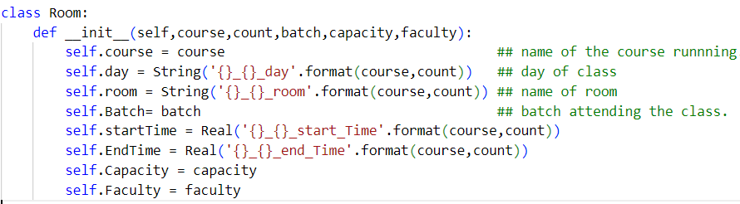
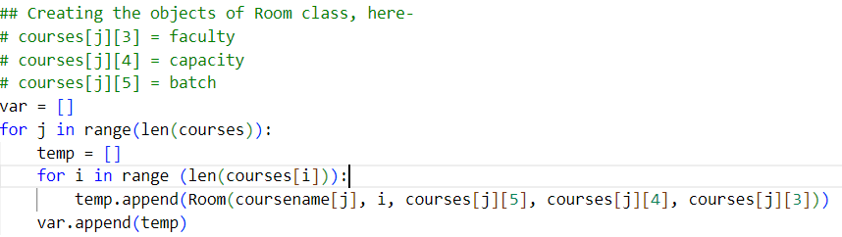
Basic Working variable- ROOM OBJECTS
I made room objects for all lectures for all courses .
This is the basic working variable on which I will be modelling the constraints. Each room object will specify its:
Course, batch
Day of class
Starting and end-time of the lecture
Capacity of room and faculty teaching that course.

Slide 9
Modelling of constraints
Constraint1- Available days for classes: (day==Mon \/ day==Tue \/ .. .. \/ day==Friday).
Constraint2- specifies that a course cannot have more than 1 class on a particular day.(distinct days) (for i in range(len(courses)): exp1 = Distinct([var[i][j].day for j in range(len(duration[i]))])
Constraint 3- for which the course time must be within the institute timings.
Constraint 4-which states that (EndTime-StartTime == Duration) for the particular course. exp = (var[i][j].EndTime - var[i][j].startTime) == (duration[i][j])
Constraint5- which specifies that if the 2 courses are different and running on same day and
(Having the same batch OR Having the same faculty teaching OR Running in the same room)
Then they must run at different timings.

Slide 10

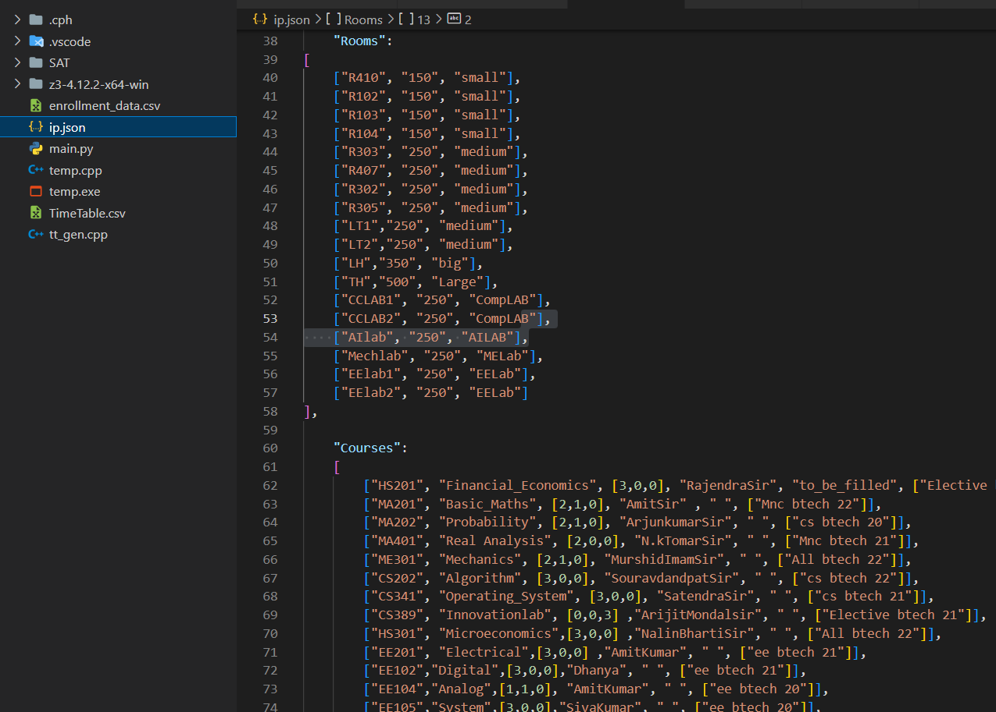
Screenshot below

Slide 11
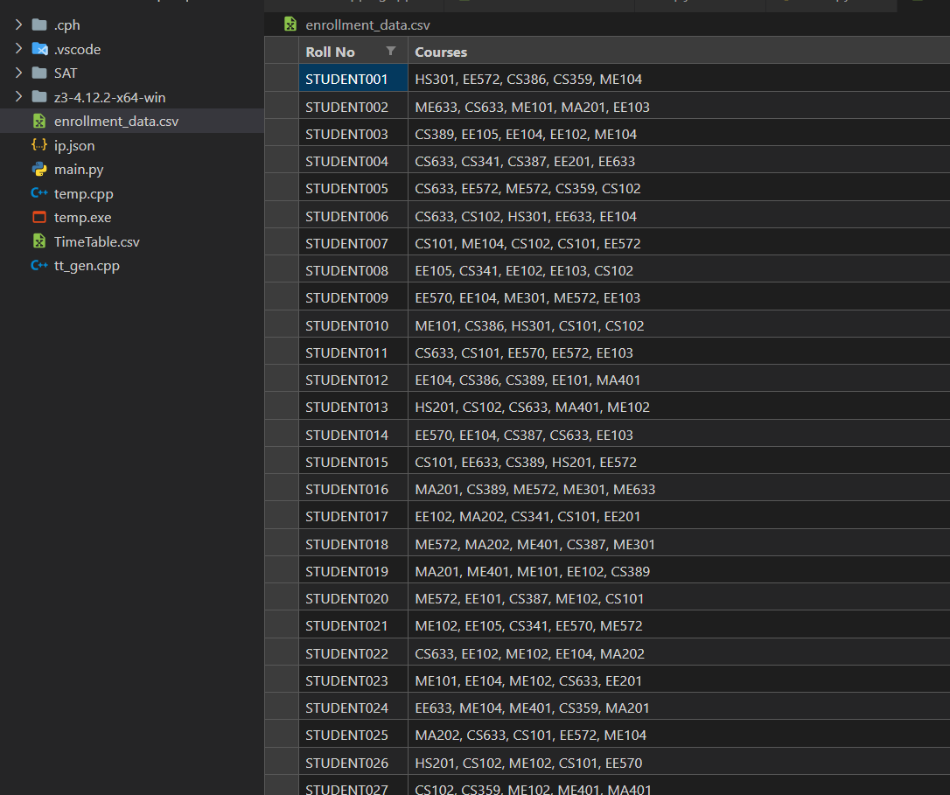
Screenshot below

Slide 12
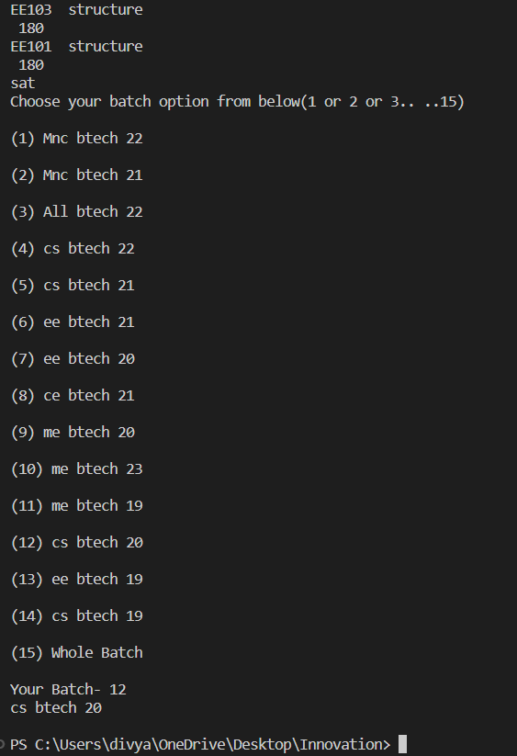
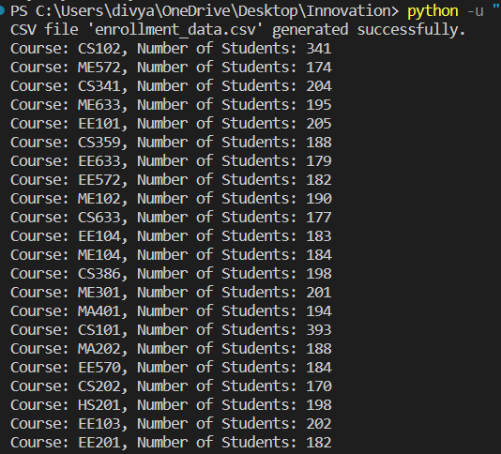
Screenshot ‘s OF Output:

Slide 13
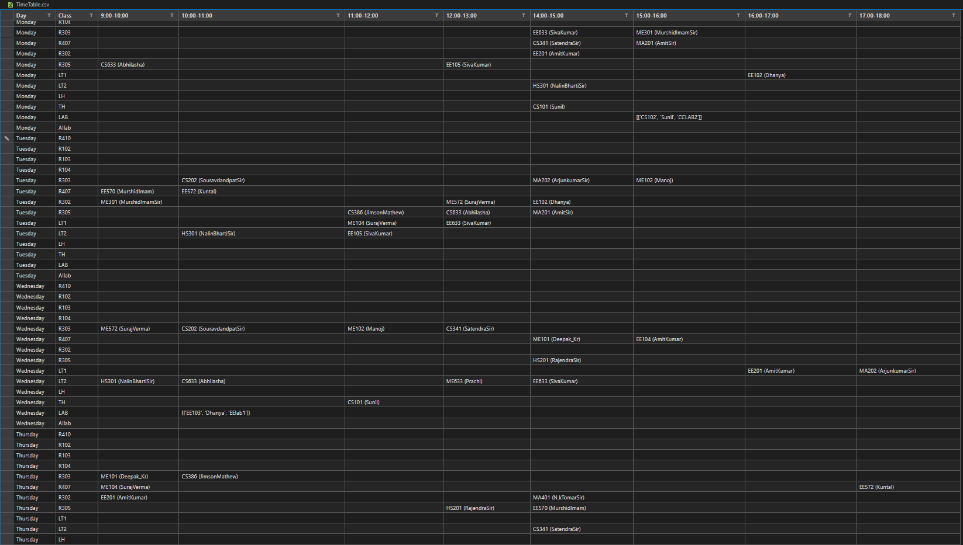
ScREENSHOT below

Slide 14
Learning & Conclusion
Learned about 3-SAT problem and various ways of representing it.(ex- DIMACS format).
How to model the constraints and feed it to the SAT- Solver using various functions.
How to open, read, write to csv files with given data.
Working and syntax of .json files and using them as input.
Got to know advanced python and how to use it for modelling constraints.
Finally it also honed my data structures and algorithm skills.

Slide 15
THANK YOU.
Prof- ARIJIT MONDAL SIR

